Slide 1
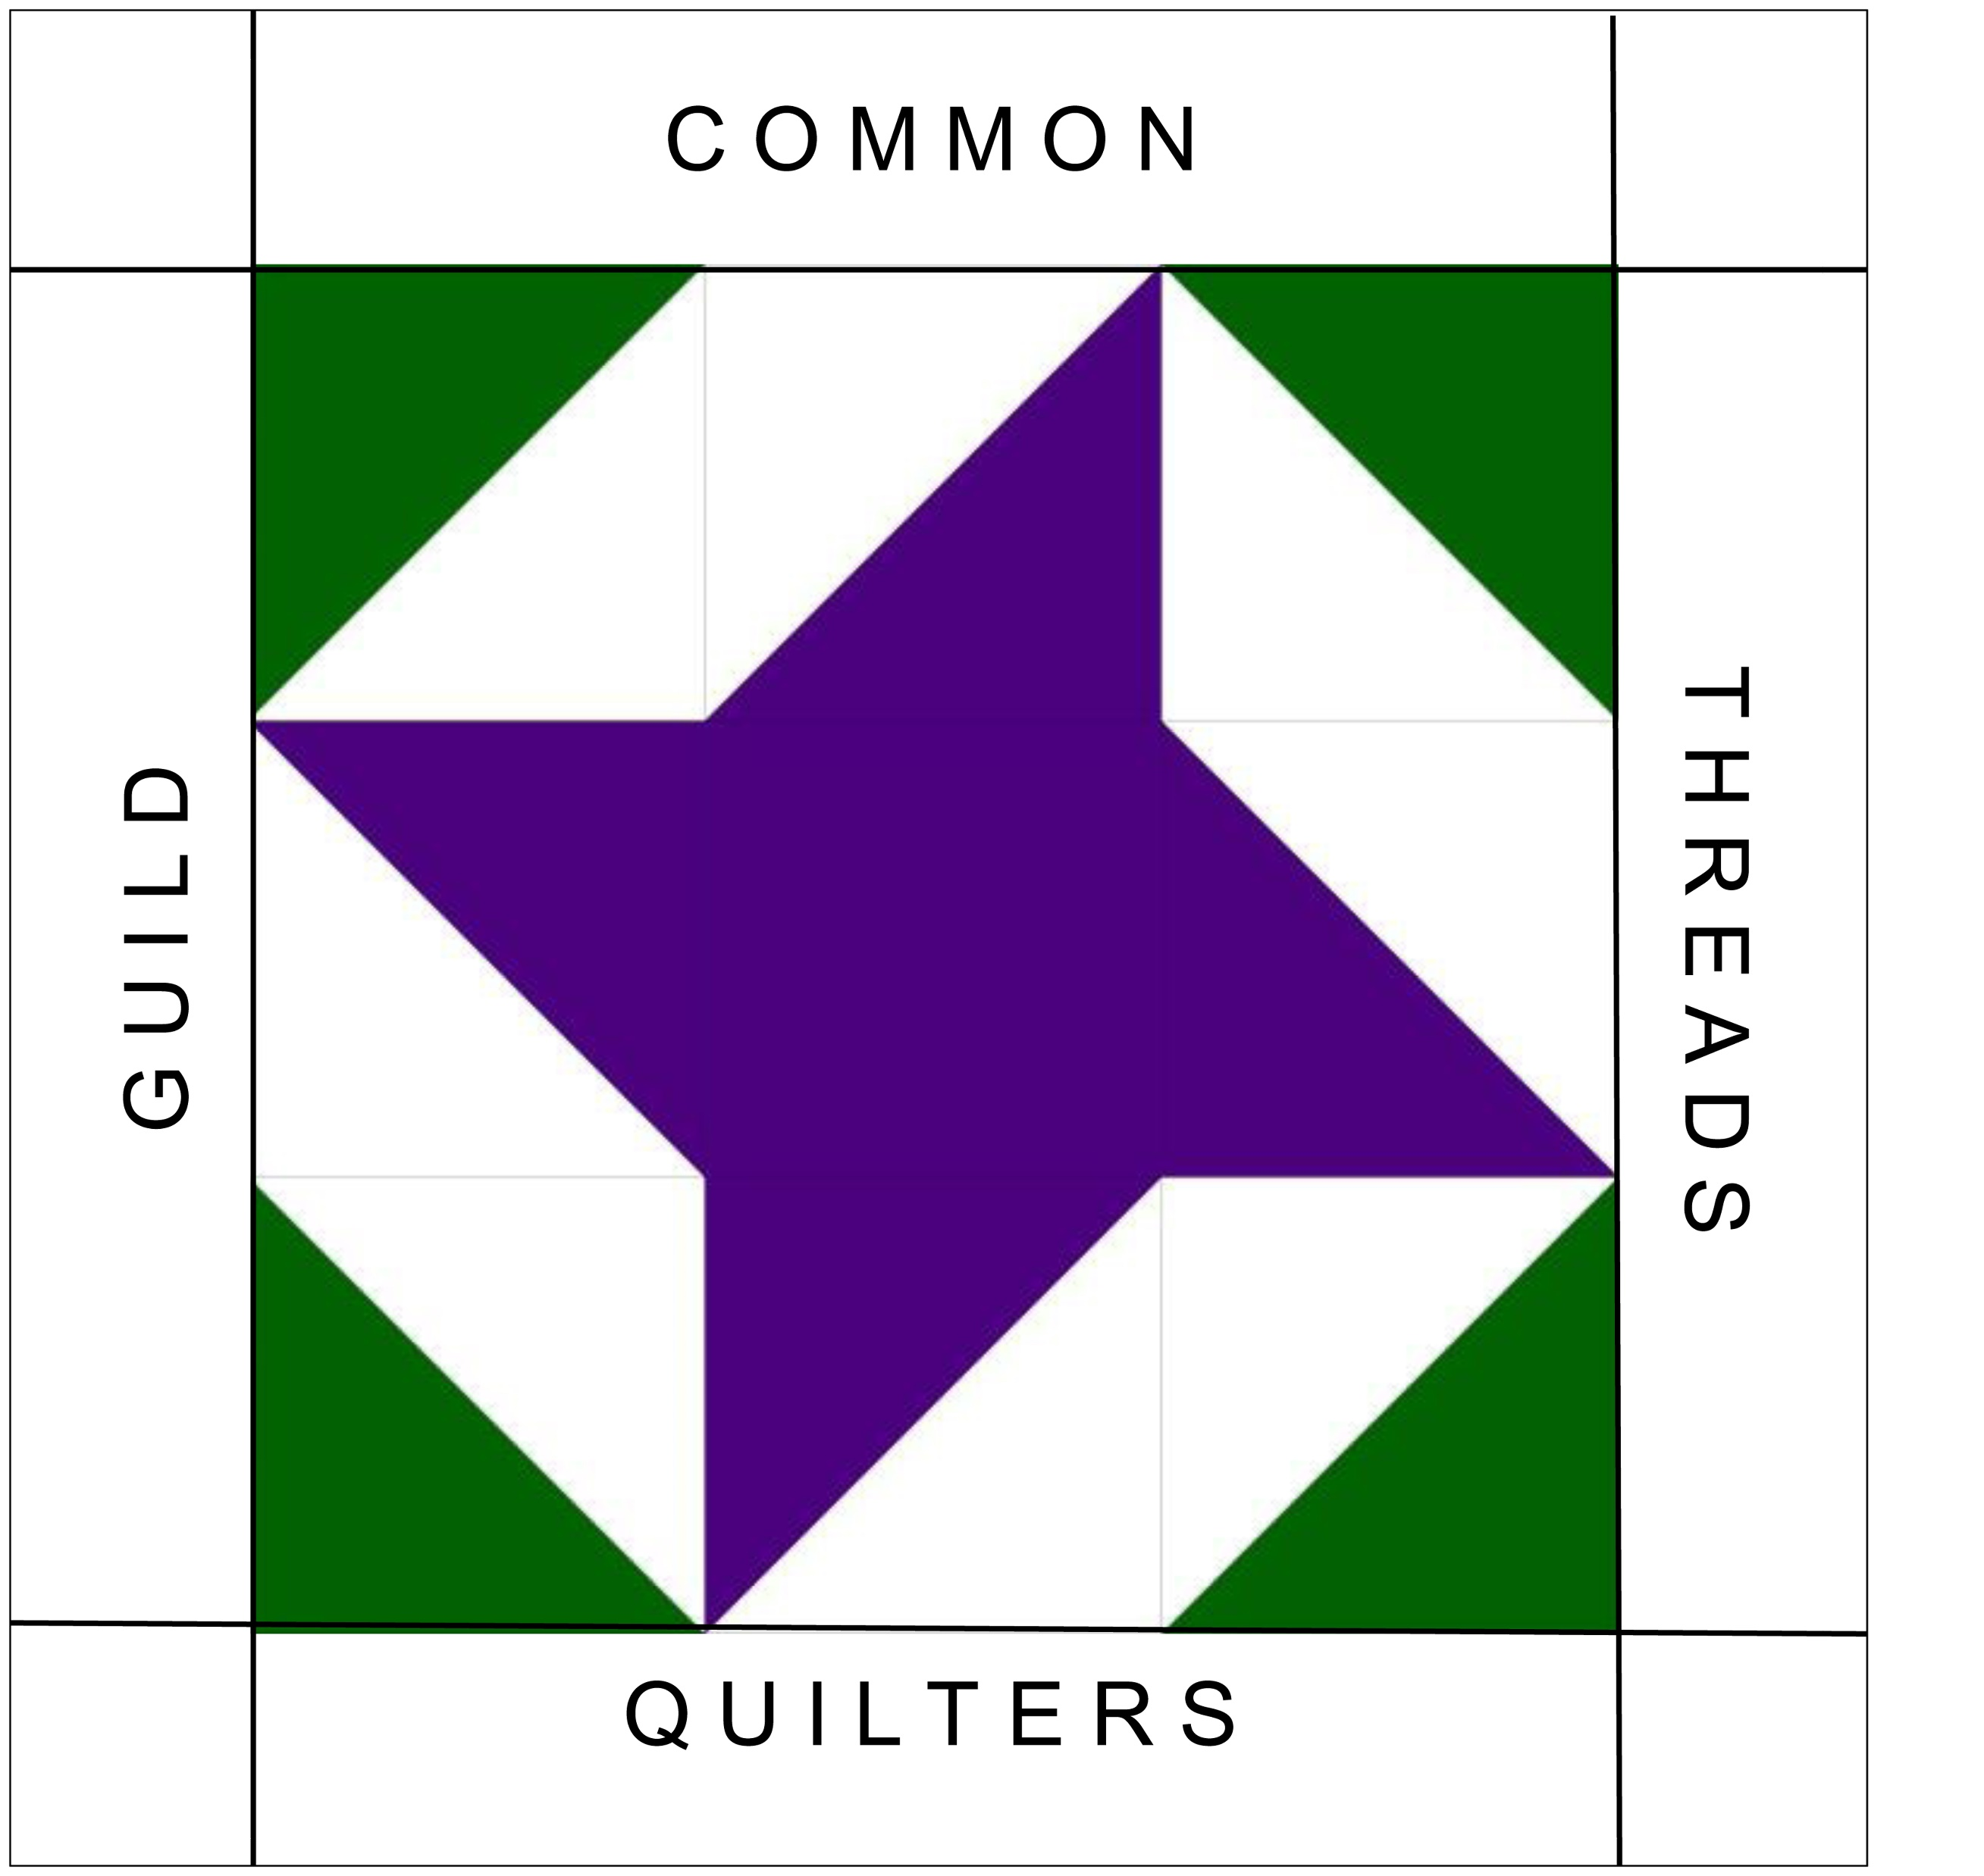
Common Threads Quilters Guild
Show & Tell
July 2021

Slide 2
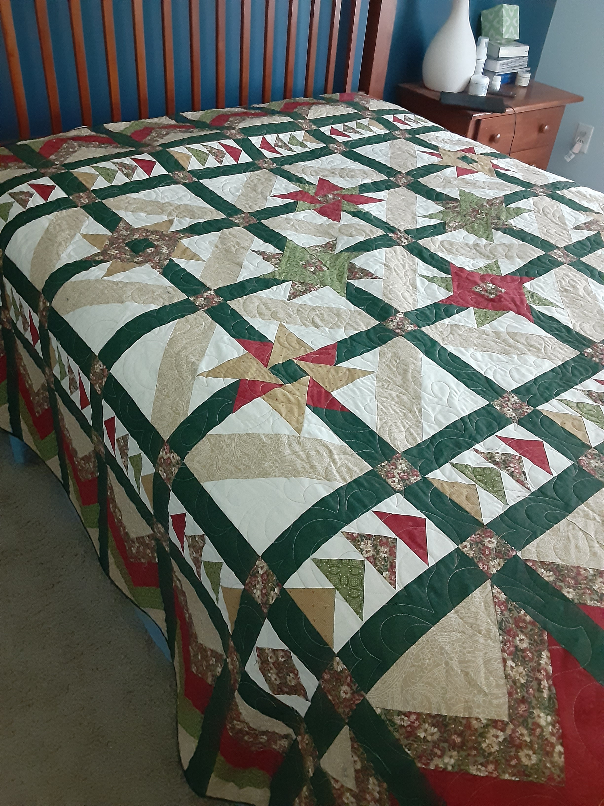
Mystery Quilt
Remember this mystery quilt designed by Judy D. several years ago?
This is Linda Burn’s finished quilt.

Slide 3
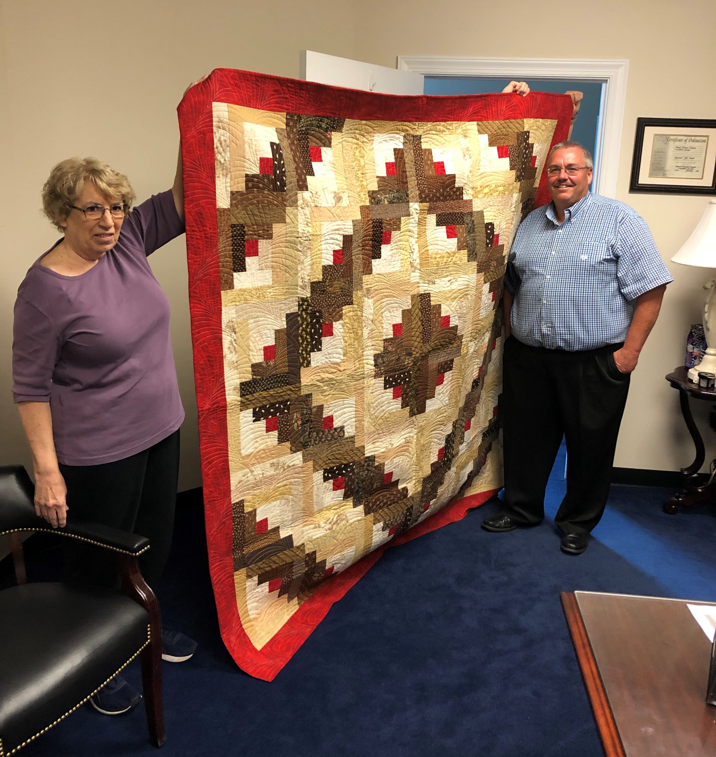
Log Cabin
JoAnn S.

Slide 4
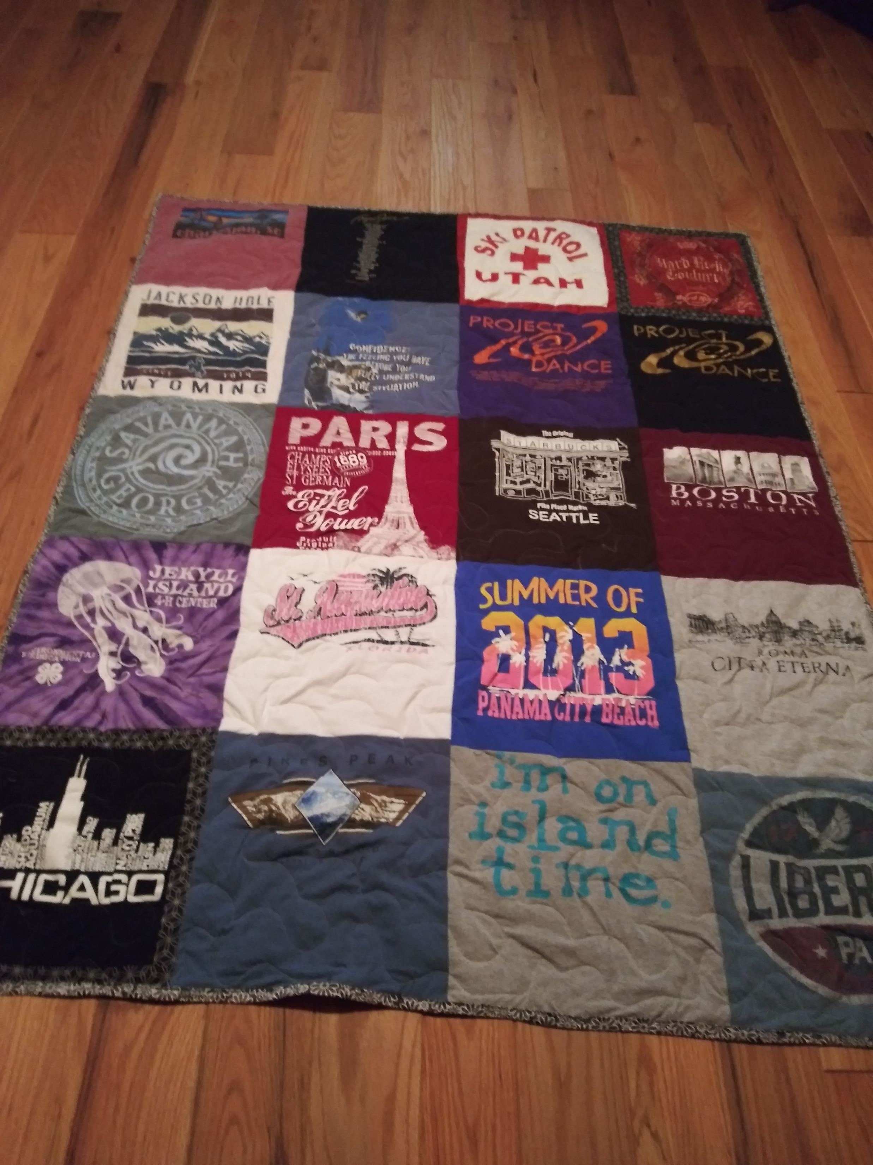
Tee-shirt Quilt
Someone’s done lots of traveling!
JoAnn S.

Slide 5
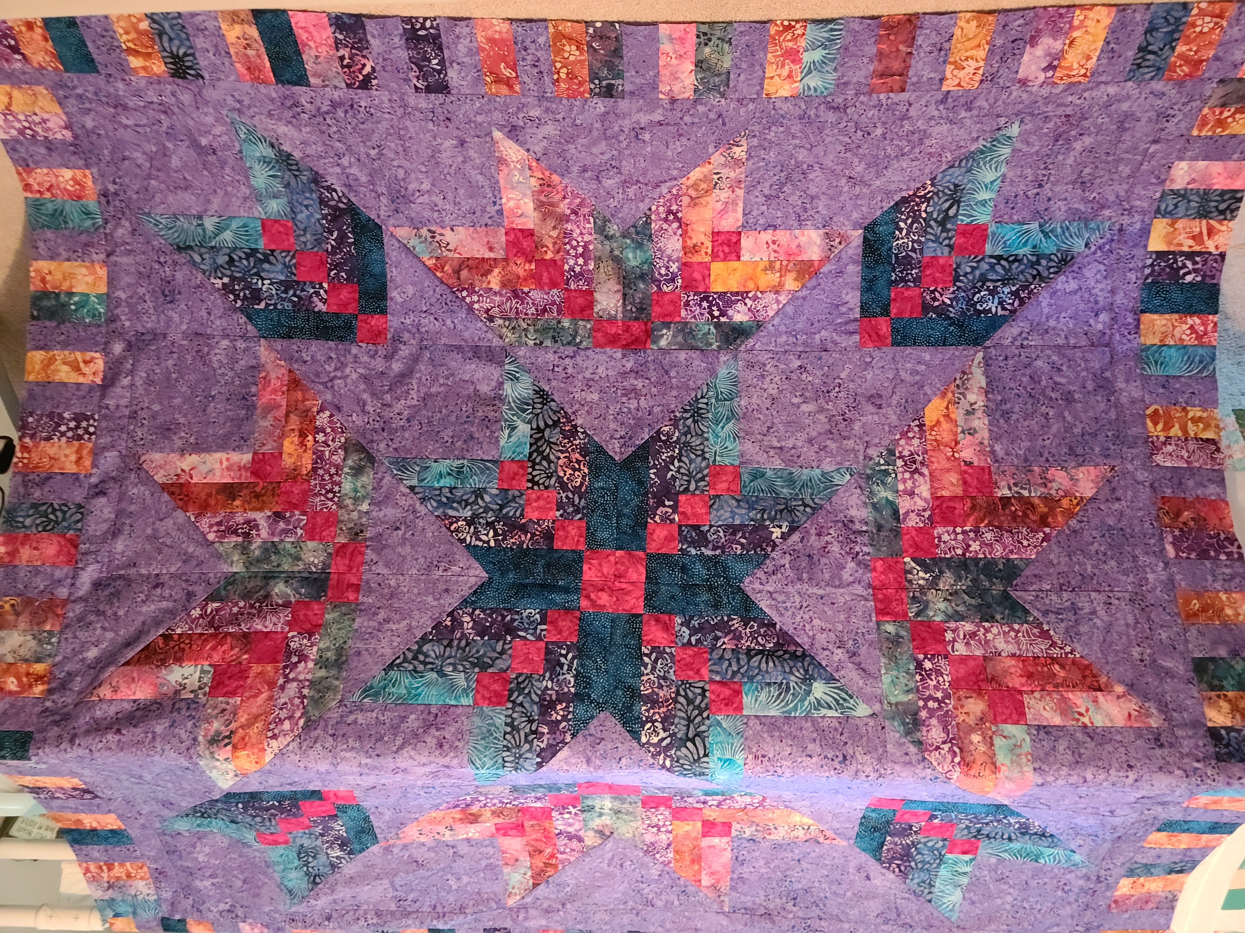
Deborah S.
Retirement gifts! Both of her quilts go to people she worked with who are retiring. How awesome!

Slide 6
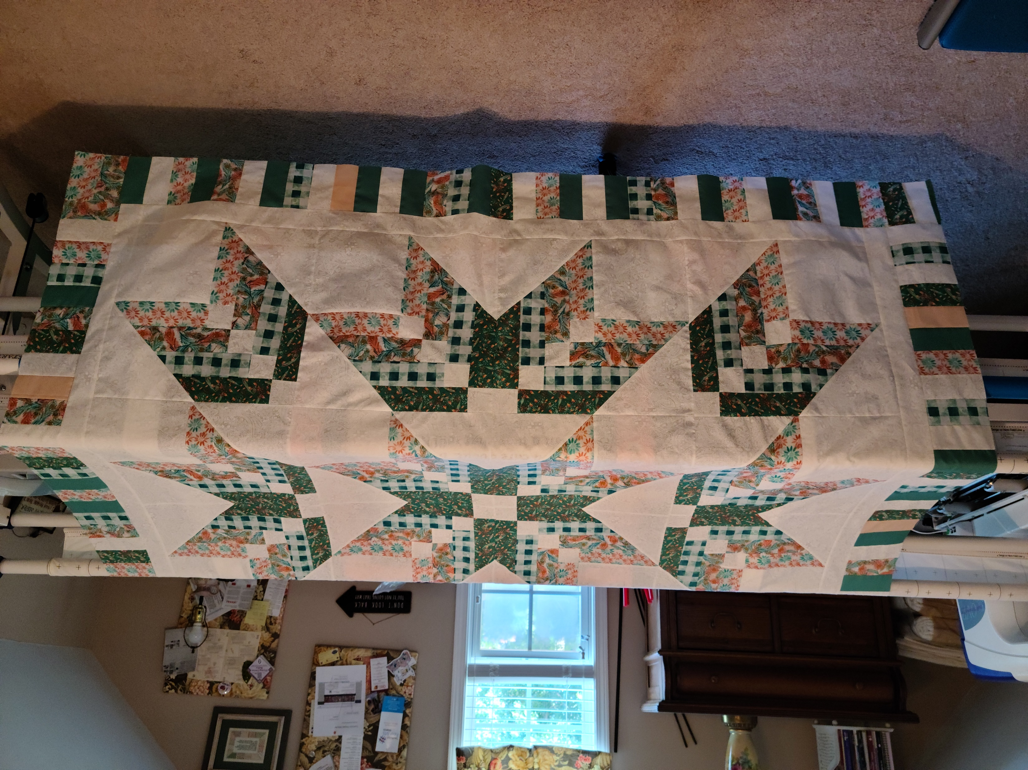
Deborah S.

Slide 7
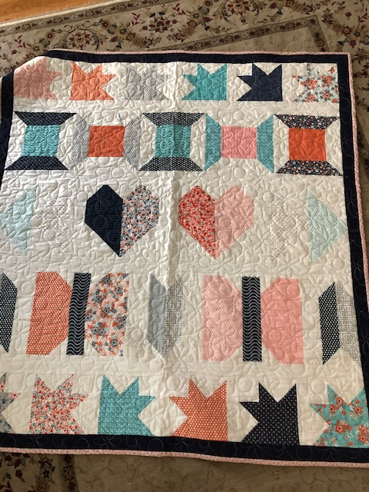
Fat Quarter Shop
Jolly Bar 2 Sampler
Jo D.

Slide 8
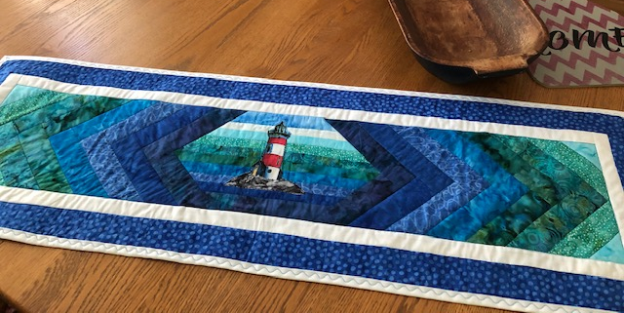
Originally a Row by Row now a table runner!
Jo D.

Slide 9
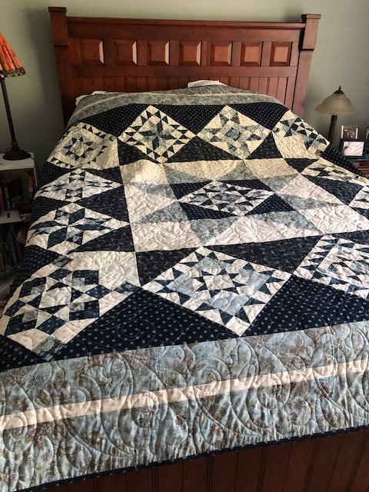
Fat Quarter Shop
Designer Mystery
2017
I call this my “Soap Opera” quilt! I was taking care of my father while in Hospice. When he watched his soap opera, I would run down and sew. The top has been completed for years, just couldn’t make myself quilt it until this year.
Jo D.

Slide 10
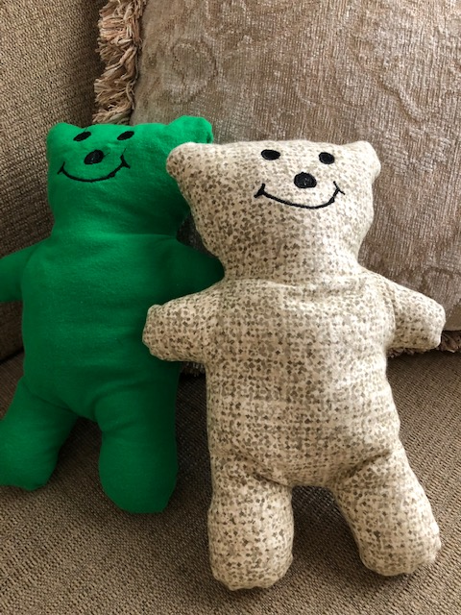
Don’t forget to
make bears for the
Summer Charity
sewing

Slide 11
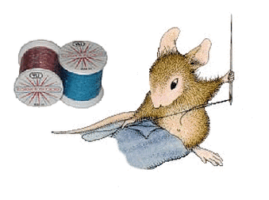
Keep on Quilting and …..
Send Jo your photos.

